Slide 1
1
Node 1
2
Node 2
3
Node 3
4
Node 4
5
Node 5
τ1 local updates
τ2 inter-node communications
W₃
3
Node 3
Step 1 | ( W₂ + W₃ + W₄ ) / 3
Step 2 | ( W₁ + 2 W₂ + 3 W₃ + 2 W₄ + W₅ ) / 9
Step 3 | ( 4 W₁ + 6 W₂ + 7 W₃ + 6 W₄ + 4 W₅ ) / 27
Step 4 | (14 W₁ +17 W₂ + 19 W₃ + 17 W₄ + 14 W₅ ) / 81
W₂
2
4
W₄
W₅
1
5
W₅

Slide 2

“propagation” eco-law
Neighbor nodes of current Node
NB 1
NB 2
…
NB n
Aggregtion
Aggregtion
Aggregtion
Current
Node
Aggregtion
<<-- Received model data
Sent model data -->>
“aggregation” eco-law
Model data of current node
Model data of NB 1
update
Model data of NB 2
Aggregated model data
Model data of current node
…
Model data of NB n

Slide 3




node i
…
node 2
W²
W^{i}
…
node n
W^{n}
W¹
node 1
Central server
Average aggregation:
Σ(n_{k}/ n_{total} )*W^{k}
⁽n_{total} = Σ n_{k}⁾

Slide 4

Aggregation
Neighbour 2
…
Spreading of W²
(3)
W²
Spreading of W⁰
(3)
Aggregation
Aggregation
(1)
Spreading of W⁰
Neighbour 1
Neighbour i
W^{i}
W⁰
W¹
(1)
(2)
Spreading of W¹
(3)
Spreading of W^{i}
W⁰
W⁰
Aggregation
(1)
…
Current node
(node 0)
(1)
W⁰
Spreading of W⁰
Spreading of W^{n}
W^{n}
(3)
(2)
Aggregation
Neighbour n
Aggregation in current node (node 0)
Model weights of the current node
W⁰
neighbour 1
W¹
Aggregation operator:
neighbour 2
W²
n^{total} <- Σ n^{i}
W⁰ <- Σ_{i=0…n}(n^{i} /n^{total}).W^{i}
Model weights of neighbour nodes
(1,2,…,n)
…
…
neighbour i
W^{i}
…
…
neighbour n
W^{n}

Slide 5
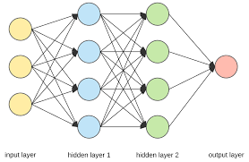
model training
Neighbour²
model training
Indirect
Neighbour
model training
Indirect
Neighbour
…
model training
model training
Neighbour^{n}
Neighbour¹
(1)
model training
local node
(N0)
model training
(1)
Model training
Indirect
Neighbour
W⁰
(1) : model training

Slide 6
Aggregation
Neighbour²
Aggregation
Indirect
Neighbour
Aggregation
(2)
Indirect
Neighbour
Spreading to neighbour² <-
…
Reception from Neighbour² ->
(4)
Aggregation
(2)
W⁰
Aggregation
Neighbour^{n}
Reception from Neighbour^{n} ->
W²
(2)
Neighbour¹
(4)
<- Reception from Neighbour¹
Spreading to neighbour^{n} <-
W^{n}
(3)
Aggregation
W¹
-> Spreading to neighbour¹
W⁰
local node
(N0)
(4)
W⁰
Aggregation
(3)
Aggregation in local node (N0)
Indirect
Neighbour
Model weights from local node
W⁰
neighbour 1
(2): Reception of models from direct neighbours
(3): Aggregation of all models
(4): Spreading of local model to direct neighbours
W¹
Aggregation operator:
neighbour 2
W²
n^{total} <- Σ n^{i}
W⁰ <- Σ_{i=0…n}(n^{i} /n^{total}).W^{i}
Model weights from neighbour
(1,2,…,n)
…
…
neighbour n
W^{n}

Slide 7
Aggregation in current node (node 0)
Model weights of the current node
W⁰
neighbour 1
W¹
Aggregation operator:
neighbour 2
W²
n^{total} <- Σ n^{i}
W⁰ <- Σ_{i=0…n}(n^{i} /n^{total}).W^{i}
Model weights of neighbour nodes
(1,2,…,n)
…
…
neighbour i
W^{i}
…
…
neighbour n
W^{n}

Slide 8









Implementation of Gossip Federated Learning with the coordination model
GED 1
GED 2
GED n
Neighbouring Edge Devices
Learning twin
Learning
Model
Learning twin
Learning
Model
Learning twin
Learning
Model
…
Coordination platform
Coordination platform
Coordination platform
W$j$^{k,1}
…
W$j$^{k,2}
W$j$^{k,n}
GED 1,2, … n Learning model weights
GED k Model weights
GED k Model weights
GED k Model weights
GED 1 Model weights
GED 2 Model weights
GED N Model weights
GED k
Aggregation applied to leaning model weights:
Spreading
W$j$^{k}
W$j$^{k,1}
W$j$^{k,2}
W$j$^{k,n}
All GED learning models have the same structure.
W_{j+1}^{k}
Aggregation mechanism
Bonding
Each GED manages model distribution and aggregation.
Decay
Model weights
W_{j}^{k}
Coordination platform
Mechanism generalised to any model : aggregation functions defined in learning model
Learning twin
Learning
Model

Slide 9
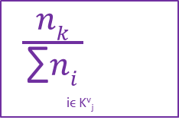
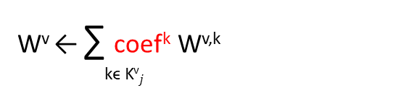
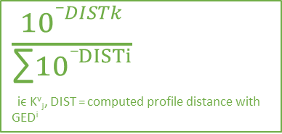
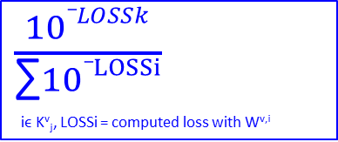
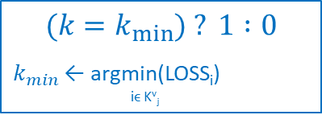
The different aggregation functions used
W^{v} ← ∑ coef^{k} W^{v,k}
kϵ K^{v}$j$
Power profile
Number of samples
Power Loss
Min loss
$\frac{nk}{\begin{aligned}\text{∑}ni \\ \end{aligned}}$
iϵ K^{v}_{j}
$\frac{10_DISTk}{\begin{aligned}\text{∑}10_DISTi \\ \end{aligned}}$
iϵ K^{v}_{j}, DIST = computed profile distance with GED^{i}
$\frac{10_LOSSk}{\begin{aligned}\text{∑}10_LOSSi \\ \end{aligned}}$
iϵ K^{v}_{j}, LOSSi = computed loss with W^{v,i}
$$(k=k_{min⁡}) ? 1 :0$$
$k_{min}$ ← argmin(LOSS_{i})
iϵ K^{v}_{j}
Quantitative approach
Approach based on the power profile similarities
Approach based on model loss
Approach based on the minimal model loss
a model which contains more samples in training data should be more accurate.
a model from a node which contains a more similar power profile should be more accurate.
how the node model prediction is similar to the validation values (use the validation data set).
the metamodel composed with the different received models does not perform that the single model that minimises the loss value.

Slide 10
Gossip Federated Learning : experimentation
Model applied on single GEDs and GEDs clusters
Experimentations with Markov chains and LSTM models
Use of topologies with 2 and 4 GEDs
Comparison of 4 different aggregators : sampling number, power loss, min loss, GED power profile

Slide 11
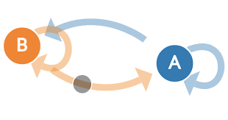
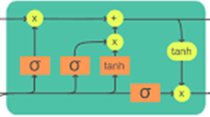
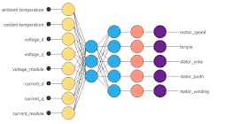
Implementation of Gossip ensemble Learning with the coordination model
Neighbour 1
learning model
Neighbour 2
learning model
Neighbour n
learning model
(1) : model training
…
calculation of predictions
NBR-1 Prediction
NBR-2 Prediction
NBR-n Prediction
Coordination platform
Coordination platform
Coordination platform
Neighbour¹
Neighbour²
Neighbour^{n}
(2)
-> Spreading to neighbour²
-> Spreading to neighbour^{n}
Spreading to neighbour¹<-
Reception from neighbour² ->
Reception from neighbour¹ ->
(2)
<- Reception from neighbour^{n}
(4)
(2)
(4)
(4)
Spreading
Aggregation applied to predictions:
Local
Prediction
NBR-1 Prediction
NBR-2 Prediction
NBR-n Prediction
Local Prediction
Aggregation mechanism
Bonding
(3)
GEDs can have different learning model type.
Decay
Coordination platform
Local
Prediction
Each EGD manages model distribution and aggregation.
GED-k Learning
model
Local node (N0)

Slide 12
Gossip Ensemble Learning : experimentation
Model applied on a single GED and on a GEDs cluster
Experimentations with Markov chains on GED-1 and LSTM models on GED-2
Comparison of 2 different aggregators : last power and power history

Slide 13
Middleware layer (Derived from Sapere Middleware)
Aggregator specification
LSA 1 (local agent)
LSA 2
LSA n
Property | object
<propName>_AGGR | obj ^{1’}
<propName> | obj ¹
Property | object
<propName> | obj 2
…
Property | object
<propName> | obj ^{n}
(3)
(1)
<operator>
<LSA
authentication>
obj¹: aggretable
obj²: aggretable
obj^{n}: aggretable
obj¹ : “upper layer” object
(class defined in the coordination platform service)
Execution of Obj1.aggregate (2)
Aggregate calculation performed by Obj1
obj^{1’}: aggretable
Retrieval of objects to aggregate from LSA properties
Execution of Obj¹.aggregate
Update of <propName>_AGGR in LSA 1

Slide 14
LSA¹
LSA²
LSA^{n}
LSA properties
LSA properties
LSA properties
Property | value
TOTAL | total1: NodeTotal
MODEL | model1: LSTMmodel
CLUSTER_MODEL | cModel1: MarkovMOdel
Property | value
TOTAL | total2: NodeTotal
MODEL | model2: LSTMmodel
CLUSTER_MODEL | cModel2: MarkovMOdel
…
Property | value
TOTAL | Totaln: NodeTotal
MODEL | modeln: LSTMmodel
CLUSTER_MODEL | cModeln: MarkovMOdel
Aggregation of TOTAL
LSA¹
LSA properties
Property | value
TOTAL_AGGR | total1’ = total1.aggregate(‘SUM’, total1, total2, …., totaln, lsa1.authentication)
MODEL_AGGR | model1’= model1.aggregate(‘samplingNb’, model1, model2, …., modeln, lsa1.authentication)
CLUSTER_MODEL_AGGR | cModel1’: cModel1. aggregate(‘PowerLoss’, model1, model2, …., modeln, lsa1.authentication)
Aggregation of MODEL
Aggregation of MODEL

Slide 15

compacted LM-1
compacted LM-2
…
compacted LM-n
(1): unpack received models
unpack
unpack
unpack
“Full” Learning Model-1
“Full” Learning Model-2
…
“Full” Learning Model-n
(2) : aggregate “full” models
Aggregation of “Full” learning models
aggregated
“Full” learning model
(3):pack aggregated model
pack
Aggregation of compacted Learning models
compacted aggregated LM

Slide 16

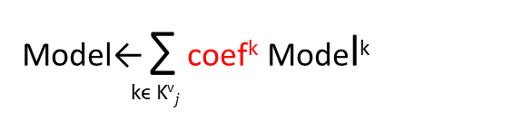
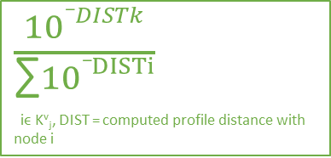

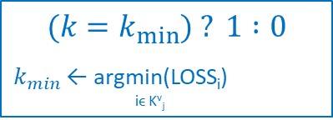
Gossip Federated Learning : the different aggregation functions used
(2)
Model← ∑ coef^{k} Model^{k}
kϵ K^{v}$j$
Power profile
Number of samples
Power Loss
Min loss
(1a)
$\frac{nk}{\begin{aligned}\text{∑}ni \\ \end{aligned}}$
iϵ K^{v}_{j}
$\frac{10_DISTk}{\begin{aligned}\text{∑}10_DISTi \\ \end{aligned}}$
iϵ K^{v}_{j}, DIST = computed profile distance with node i
(1b)
(1d)
$\frac{10_LOSSk}{\begin{aligned}\text{∑}10_LOSSi \\ \end{aligned}}$
iϵ K^{v}_{j}, LOSSi = computed loss with W^{v,i}
(1c)
$$(k=k_{min⁡}) ? 1 :0$$
$k_{min}$ ← argmin(LOSS_{i})
iϵ K^{v}_{j}
Quantitative approach
Approach based on the power profile similarities
Approach based on model loss
Approach based on the minimal model loss
a model which contains more samples in training data should be more accurate.
how the node model prediction is similar to the validation values (use the validation data set).
the metamodel composed with the different received models does not perform that the single model that minimises the loss value.
a model from a node which contains a more similar power profile should be more accurate.

Slide 17

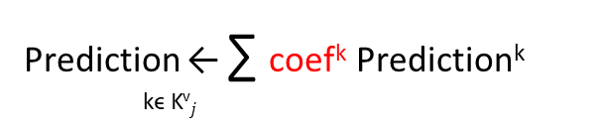
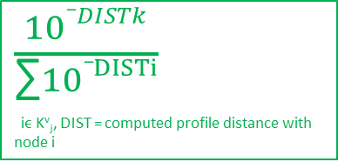
Gossip Ensemble Learning : the different aggregation functions used
(2)
Prediction ← ∑ coef^{k} Prediction^{k}
kϵ K^{v}$j$
Last Power
Power profile
(1a)
$\frac{10_DISTk}{\begin{aligned}\text{∑}10_DISTi \\ \end{aligned}}$
iϵ K^{v}_{j}, DIST = computed profile distance with node i
(1b)
$\frac{10_DISTk}{\begin{aligned}\text{∑}10_DISTi \\ \end{aligned}}$
iϵ K^{v}_{j}, DIST = computed profile distance with node i
Approach based on the last state similarities
Approach based on the power profile similarities
a prediction from a node which contains a more similar state should be more accurate.
a prediction from a node which contains a more similar power profile history should be more accurate.

Slide 18
Composed
Patterns
Gossip
Basic
Patterns
Bonding
Decay
Aggregation
Spreading

